Slide 1
“FOOD DILIVERY WEB APPLICATION”
SUBMITED BY
PAYAL GANESH PATIL
OMKAR SAMPAT HANDORE
GUIDED BY:- PAWAN MALANI SIR
Department Of Computer Science.
K.K.Wagh Arts, Commerce, Science and Computer Science College.
Nashik-422003 Academic Year2020-2021

Slide 2
INDEX
Sr.No | Title | Page NO.
1. | Problem Definition. | 5
2. | Existing System. | 6
3. | Proposed System. | 7
4. | Requirement Analysis | 8
5. | Scope of the system | 9
6. | Feasibility study | 10
8 | ERD | 11
9. | UML Diagrams. | 12
10. | Data Dictionary. | 20
11. | Sample I/O Screen. | 23
12. | Conclusion | 29
13. | Future Enhancement | 30
14. | Bibliography | 31

Slide 3
Problem Definition
The existing system has man of the drawbacks. Also it is not user friendly & complex.
Also it is not that responsive.
The website is not hosted on the web.
The contact and feedback option is not provided.
The main drawback of the existing system is that it doesn’t have the Android application.

Slide 4
Existing System
The existing system has man of the drawbacks. Also it is not user friendly & complex.
Also it is not that responsive.
The website is not hosed on the web.
The contact and feedback option is not provided.
The main drawback of the existing system is that it doesn’t have the Android application.

Slide 5
Proposed System
The proposed system is very responsive & easy to handle .also user friendly.
All the billing get generated with the calculated total of the products that customer add to its cart.
Also having feedback option through which customer can add his/her valuable feedback. & all contact details including the restaurant map is provided on website
The admin panel is more effective & all the reports of register user, cart information & product information also maintained in well format. The print option is also provided so that user can print the bill.
The main efforts we take in new system is that android application is also available for our website

Slide 6
Requirements Analysis
Minimum Hardware Requirements
PROCESSOR RAM
: Intel(R) Core(TM) i5
: 8.00 GB
Minimum Software Requirements
OPERATING SYSTEM LANGUAGE BACK_END
WEB BROWSER
:
:
:
:
Windows 10 PHP.
MySql.
Mozilla, Chrome, (OTHERS)

Slide 7
Scope and objective of the system
In order to be able to define our system architecture ,we must first dearly state what our objective at the same one of our objective is to create an experience ,which is not unique to the customer ,client but also makes him feel that he has loyal attachment to the system and approaches us whether he/she needs.
To achieve better result & success by implement computerized process instead of manual process.
Feasibility study
The feasibility study is useful to evaluate the cost and benefits of the system request the feasibility study tries anticipating, future scenario of software development.
There are 3 major aspects of in the feasibility study:
Technical feasibility
Economical feasibility
Operational feasibility
Technical Feasibility:
Technical feasibility of food ordering system focused on the existing computers hardware, software and personnel. This also includes need for more hardware, software and personal and possibility of installing such a facility

Slide 8
Economical Feasibility:
Economical feasibility considers the cost of benefit analysis of the proposed system. The benefits are always expected to be owner weighting the cost. It is helpful to find the system development cost and checks whether it is justifiable for that it checks investigation cost, salaries and maintain ace cost etc.
Operational Feasibility:
It is considered the acceptance of system. It checks whether the system will be used if it is system will be used and implement are the users of system able to handle the system whether the proposed system causes any trouble etc.

Slide 9
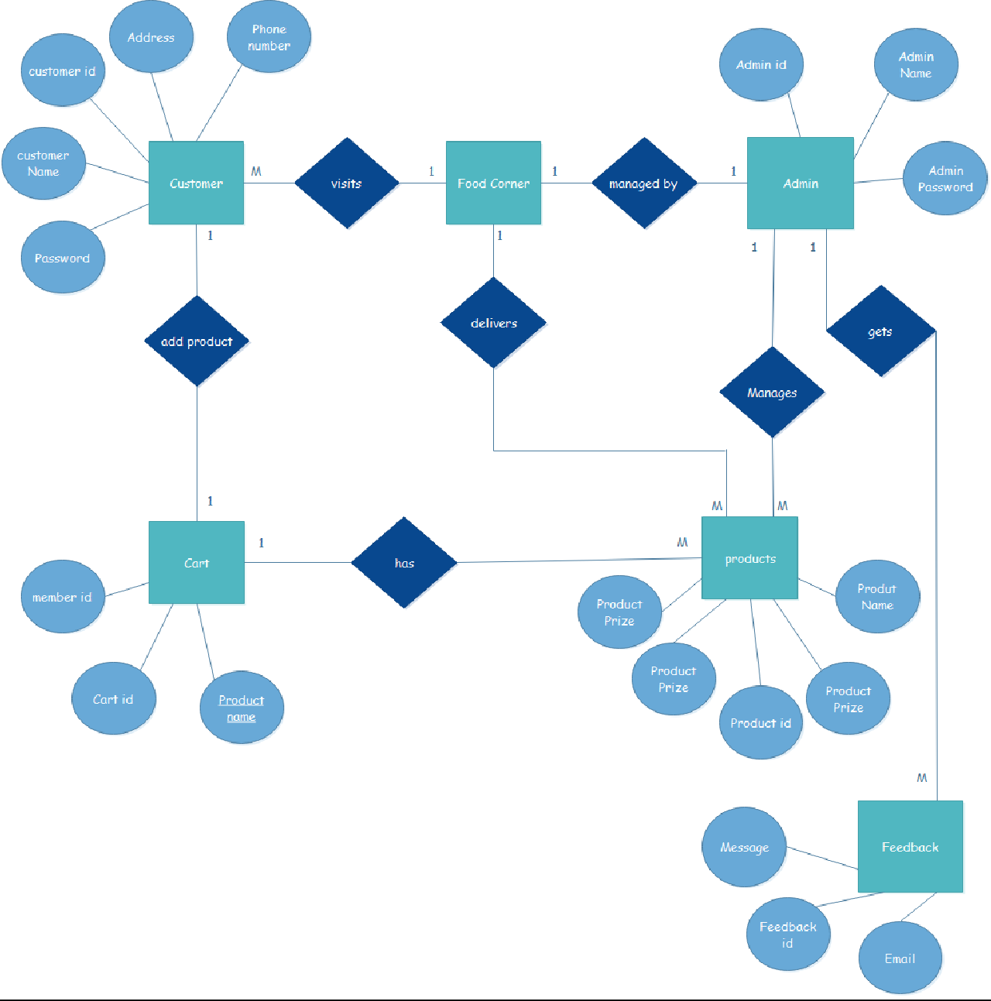
ERD:

Slide 10
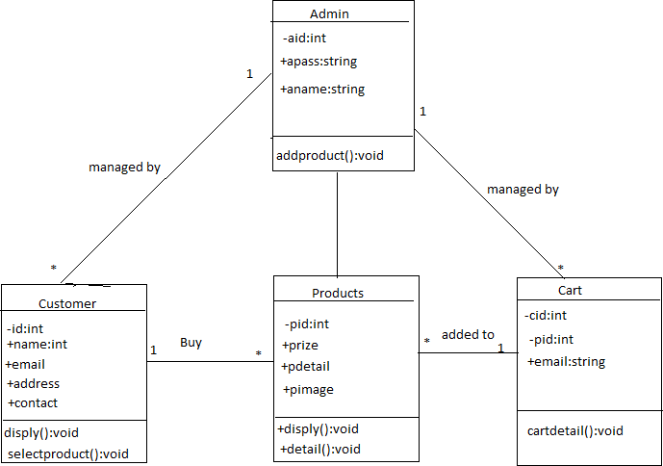
UML Diagram
Class Diagram:

Slide 11
Use case Diagram:
Add product
Add category
View registed View bill info
Admin
View feedback
Search food
Order food
Give feedback
Customer

Slide 12
Sequence Diagram (User)
Customer
Web Application
Database
Visits
Create account Message received
Login
Information Stored
Validates information Check Availability Item Available
View product
Add to cart Check out Bill payment
Database updated conformation message
Logout

Slide 13
Sequence Diagram (Admin)
Admin
Web Application
Database
login
Validates information
Access Granted
Add or update products View user information
database updated
View cart
Delete items Delivers items
database updated
Clears cart
database updated
View feedback
Logout
conformation message

Slide 14
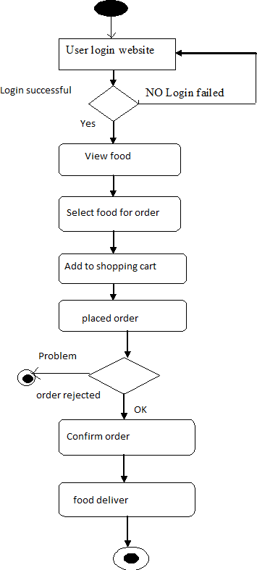
Activity Diagram(User)

Slide 15
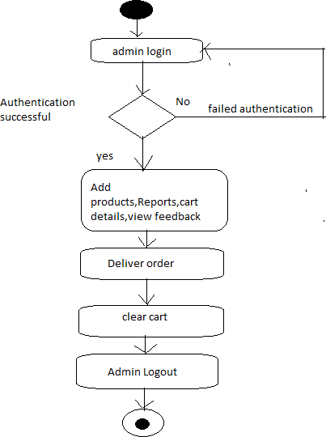
Activity Diagram(Admin)

Slide 16
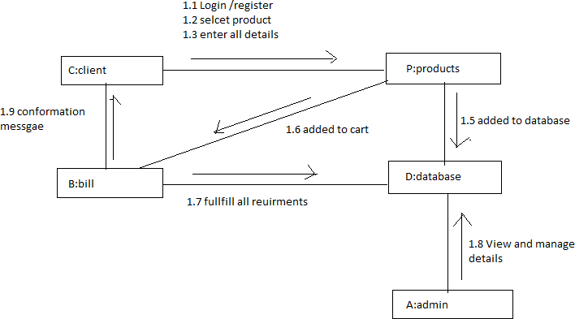
Collabration Diagram

Slide 17
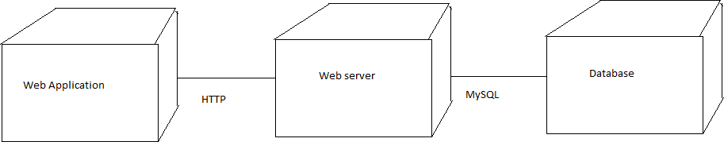
Deployment Diagram

Slide 18
Data Dictionary
Register:
Field name | Datatype | Constraints
Memberid | Int | Primary key
Name | Varchar(30) | -
Emailid | Varchar(30) | -
password | Varchar(30) | -
Contactno | Int | -
Address | Varchar(200) | -
Addproduct:
Field name | Datatype | Constraints
Productid | Int | Primary key
Pname | Text | -
Pprize | Varchar(10) | -
Pdetail | Varchar(200) | -
Pimage | Text | -
Categoryid | Int | Index

Slide 19
Category:
Field name | Datatype | Constraints
Categoryid | Int | Primary key
Cname | Varchar(20) | -
Addtocart:
Field name | Datatype | Constraints
Cartid | Int | Primary key
Email | Varchar(50) | -
Productid | Int | Index
Memberid | Int | Index
Adminlogin:
Field name | Datatype | Constraints
Aid | Int | Primary key
Aname | Varchar(50) | -
Apass | Varchar(50) | -

Slide 20
Checkout:
Field name | Datatype | Constraints
Coid | Int | Primary key
Email | Varchar(50) | -
Add | Varchar(50) | -
Phone | Int | -
Date | Date | -
Memberid | Int | Index
Feedback:
Field name | Datatype | Constraints
Feedbackid | Int | Primary key
Fname | Varchar(50) | -
Femail | Int | -
Message | Text | -
Memberid | Int | Index

Slide 21
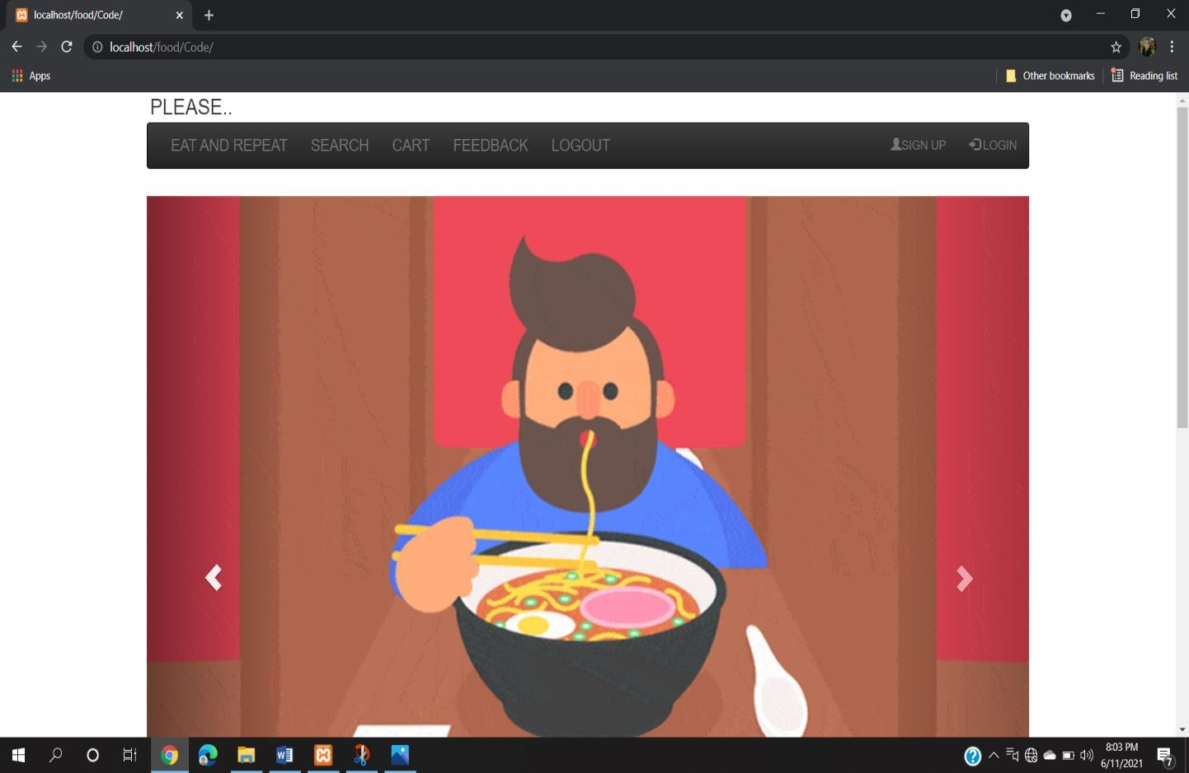
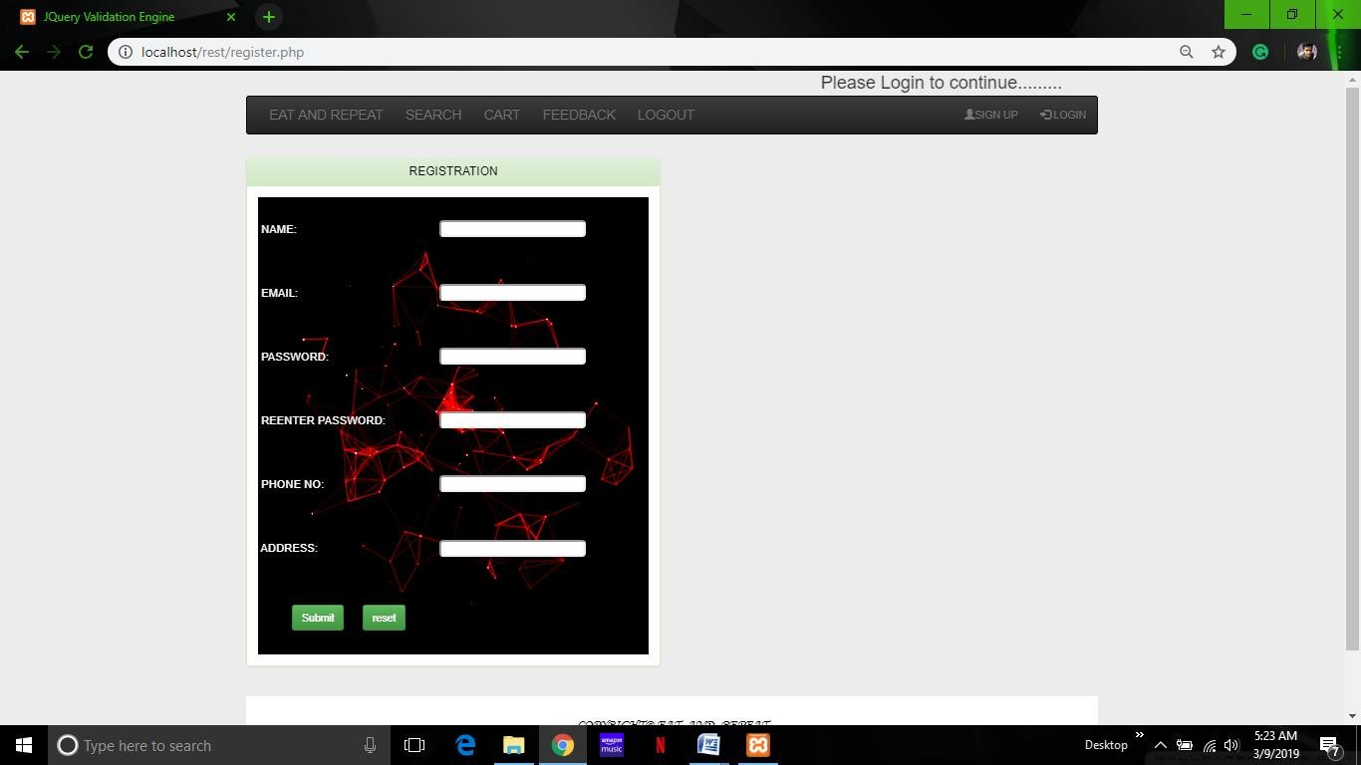
SAMPLE I/0 SCREEN

Slide 22
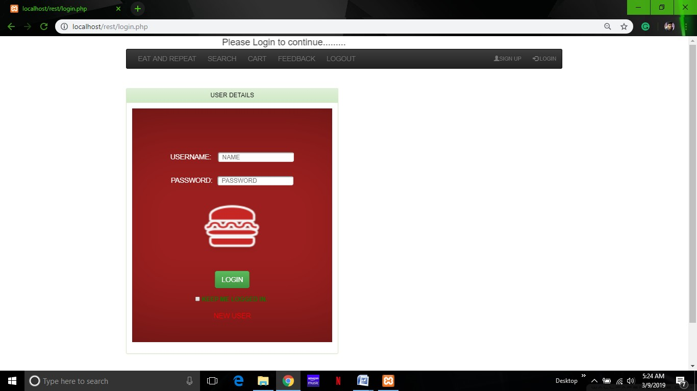

Slide 23
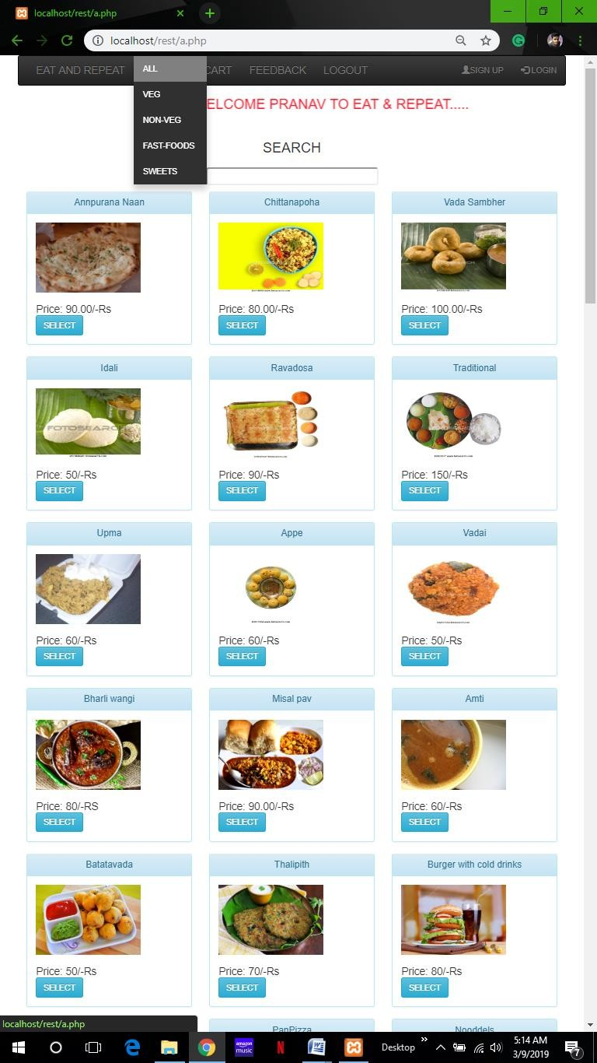

Slide 24
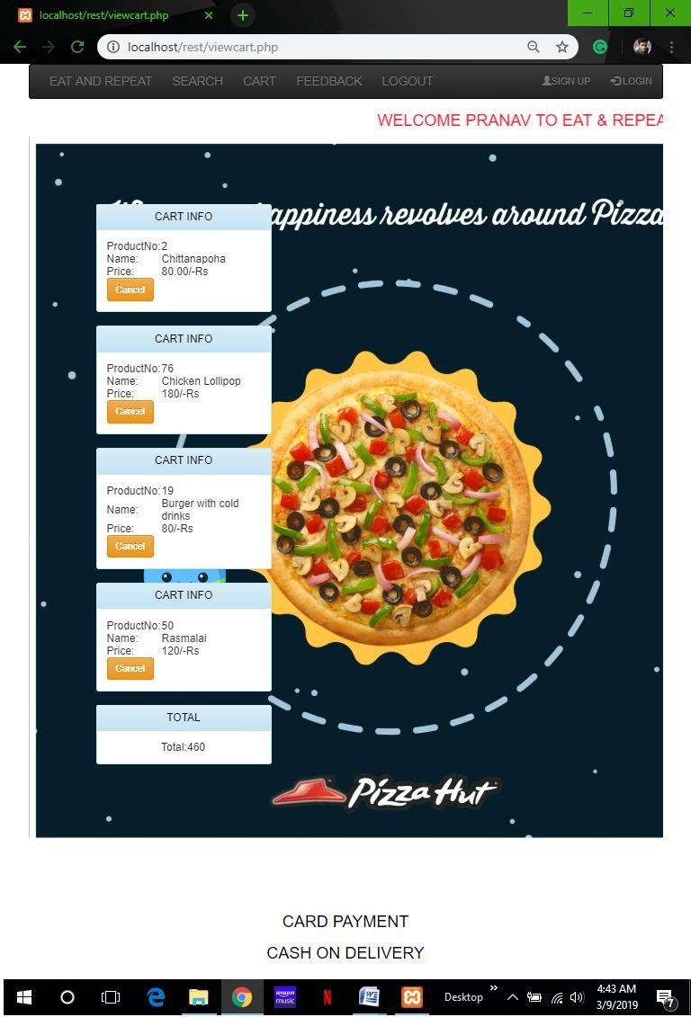

Slide 25
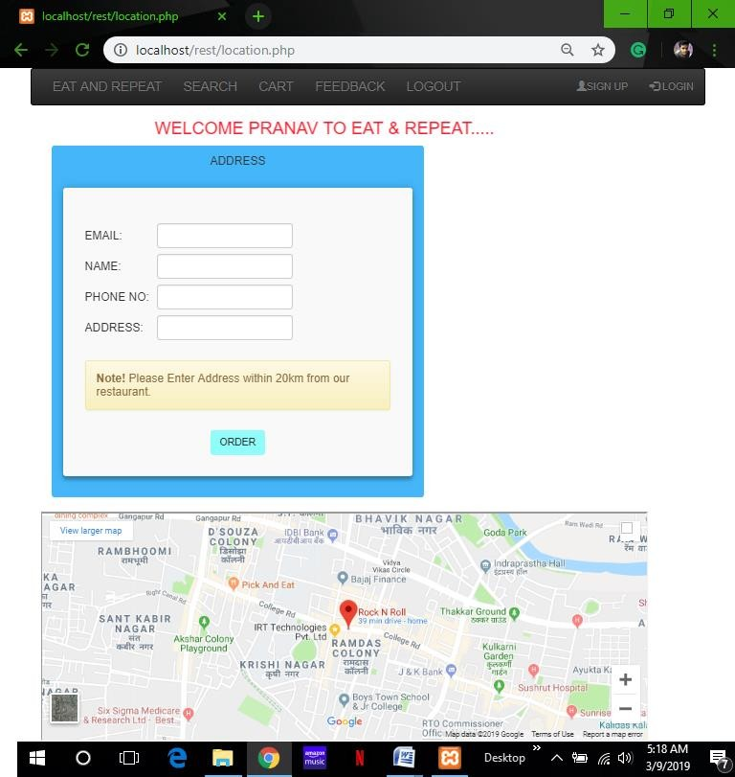

Slide 26
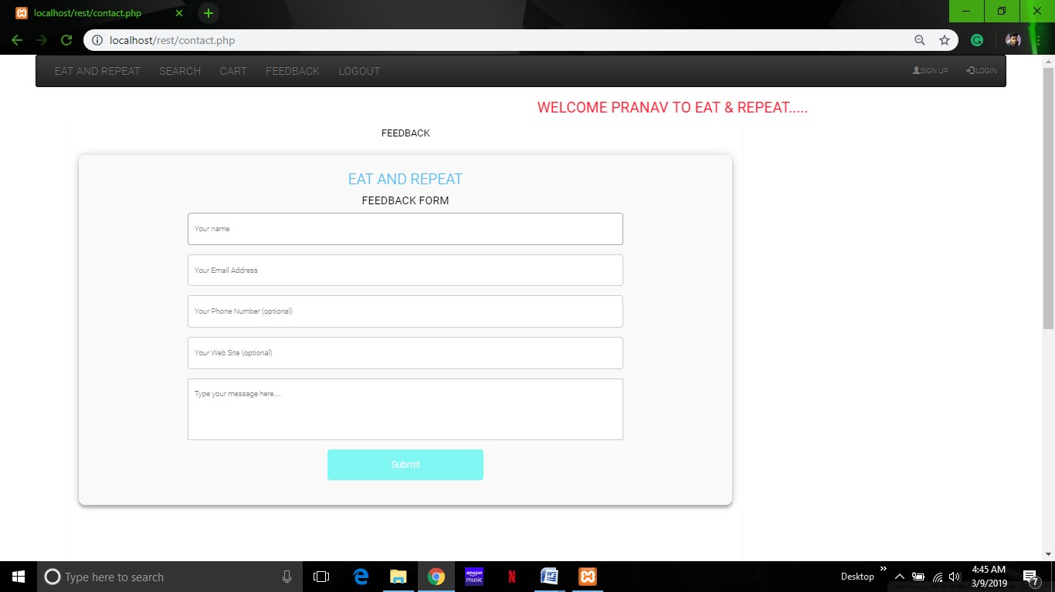
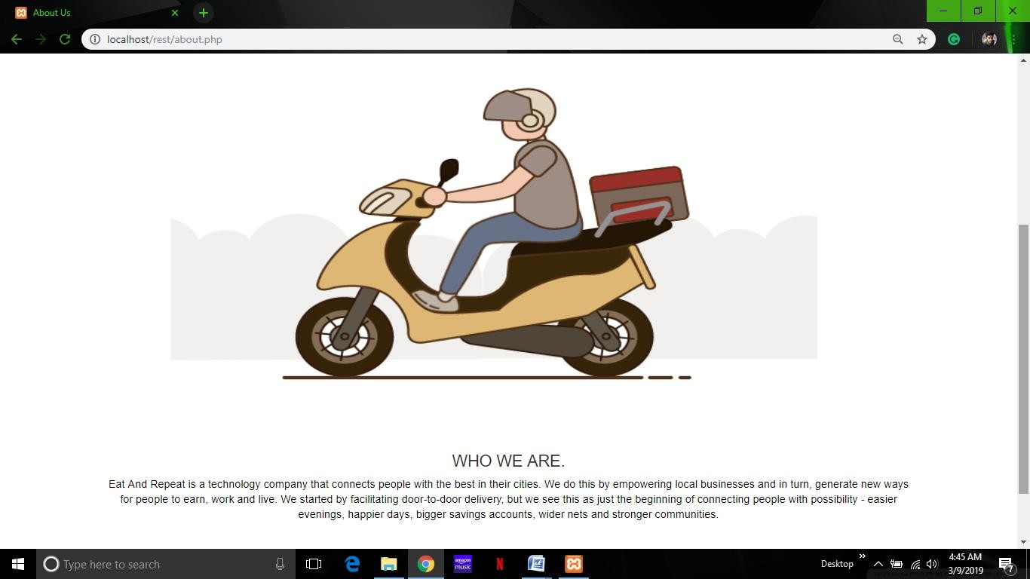

Slide 27
Conclusion
It is concluded that the application works well and satisfy the customers’ needs.
The application is tested very well and errors are properly debugged.
It can access on any system and on the android smart phones.
The application works accurate to the restriction provided in their browser.
Further enhancement can made to the application to make it more attractive and user-friendly

Slide 28
Future Enhancement
Every application has its own merits and demerits.
The project has covered almost all its requirements.
Further if we want any changes or improvement then it can be done.
Also the online transaction is the one which is our future enhancement.
Further we will improve the website by including more features and make it attractive.

Slide 29
Bibliography
Php tutorial
Android tutorial
http://www.W3Cschool.com
Reference books:
Learning PHP,Mysql and Javascript by Robin Nixon
PHP Solutions:Dynamic Web Design Made Easy by David Powers

